Slide 1


Anomaly Detection and Root Cause Location for Cloudified Network AsiaLab 2021-12-2
ITUAI/MLin5GGlobal Challenge

Slide 2
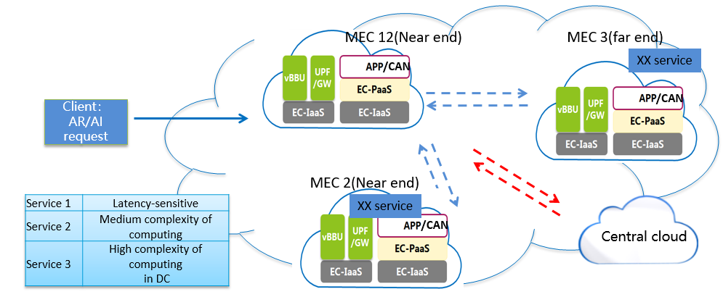

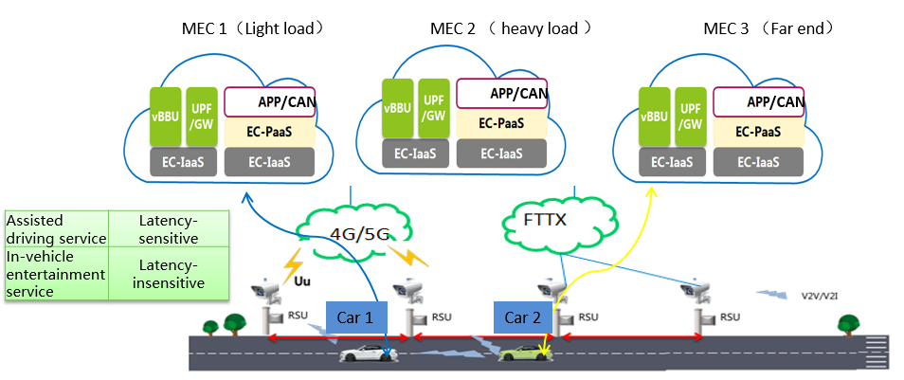




Technical Trend
NFV and SDN promote the development of network clouding and realize cloud network convergence in 5G.
Computing-Aware Networking will make further efforts on network clouding.
5G network-cloud convergence
5G Computin-Aware Network
Public Cloud1
Private Cloud1
Private Cloud 2
Public Cloud2
Internet
ONT/SDH
SD-WAN
private line
Home Broadband
Branch A
Branch B
Branch C
Core Network
Public Cloud
5G Slice
5G Private Network
Cloud-Edge Collaboration
CPE
5G
PE
POP
Private Network
Branch D
UPF
Edge-Cloud
Public Cloud
MEC
POP
PE
Internet
PE
Use cases and requirements of computing-aware networking for future networks including IMT-2020
ITU SG13-TD561/WP1

Slide 3
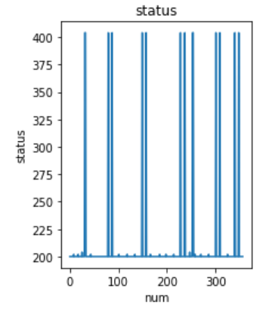
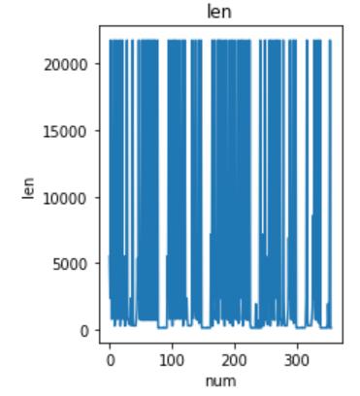
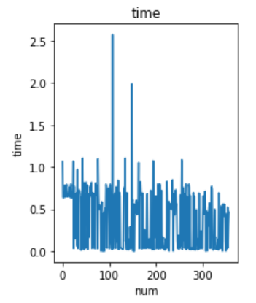
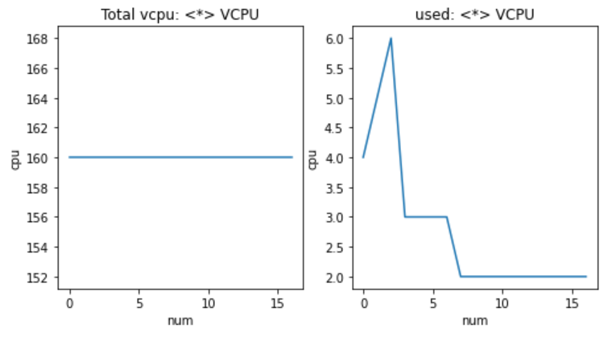
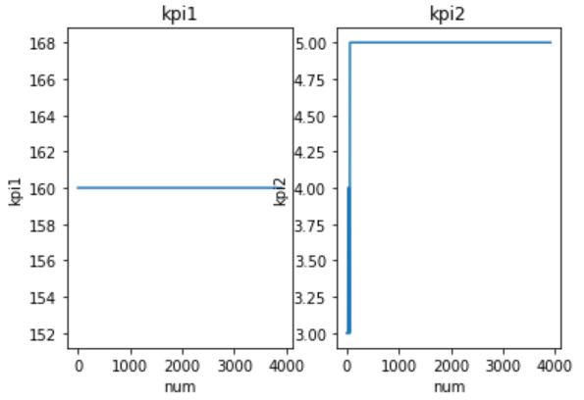
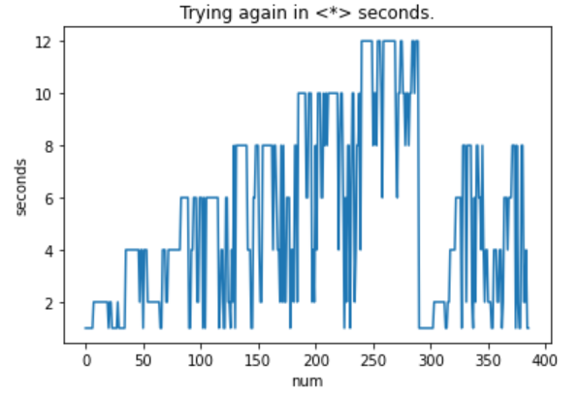
Business Challenge
Anomaly Detection and Root Cause Location is the core function of network intelligent operations.
In actual business scenarios, existing algorithms fail to extract the key information of the log completely, and detect the anomaly log accurately .
various features of the operation log from network cloudified equipments

Slide 4

Task Analysis
High accuracy and real-time requirements of anomaly detection and root cause location are the challenges in the competition and real application.
Data Provided Tasks Evaluation
Training log：
223456 normal log
0 anormal log
F1-Score: 70%
InTimeScore:15%
PerformanceScore:15%
Modeling
Log anomaly detection
Root cause location
Scoring
formula
Test log：
1124 log fragments
normal & anormal

Slide 5
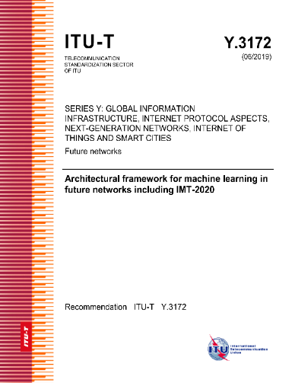
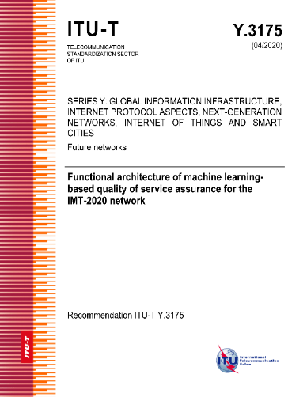
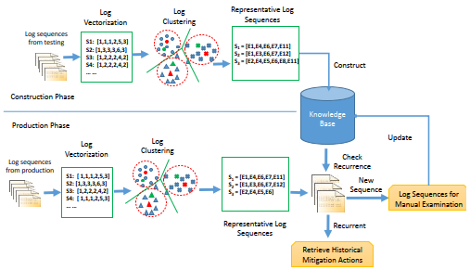
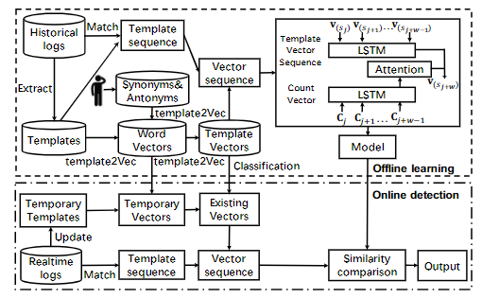
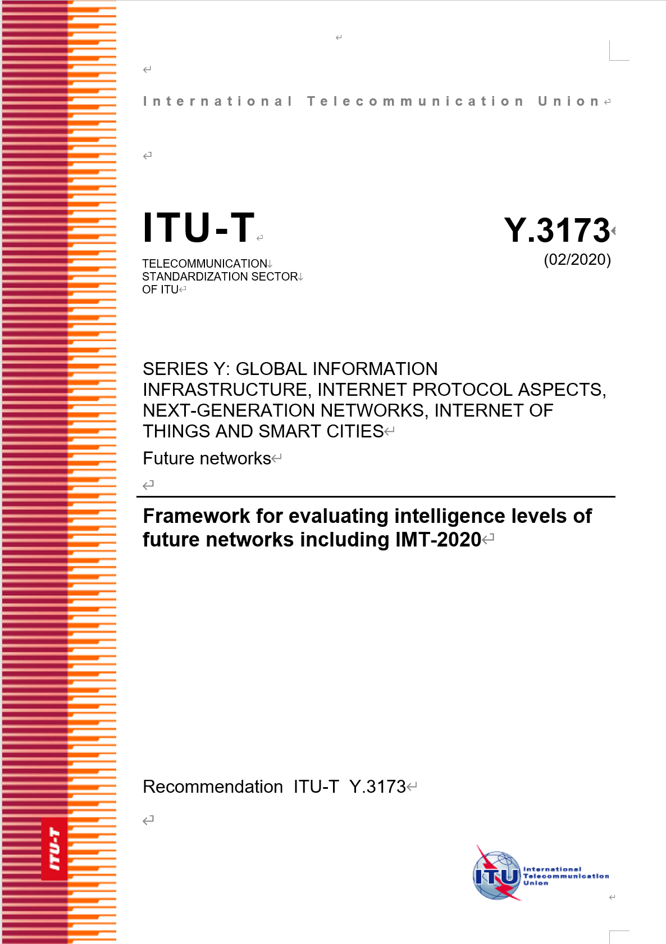
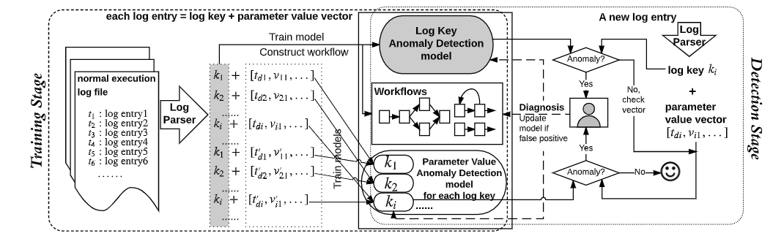
Reference & ITU AI Standards
ITU has specified some network intelligence use cases of log anomaly detection.
Researchers have proposed some classical algorithms for such cases.
ITU AI Standards
Reference
Q. Lin, H. Zhang, J.G. Lou, Y. Zhang, and X. Chen. Log clustering based problem identification for online service systems. In ICSE’16: Proc. of the 38th International Conference on Software Engineering, 2016
Meng W, Liu Y, Zhu Y, et al. LogAnomaly: Unsupervised Detection of Sequential and Quantitative Anomalies in Unstructured Logs[C]//IJCAI. 2019, 19(7): 4739-4745.
Du M, Li F, Zheng G, et al. Deeplog: Anomaly detection and diagnosis from system logs through deep learning[C]//Proceed⁃ ings of the 2017 ACM SIGSAC Conference on Computer and Communications Security. 2017: 1285-1298.

Slide 6
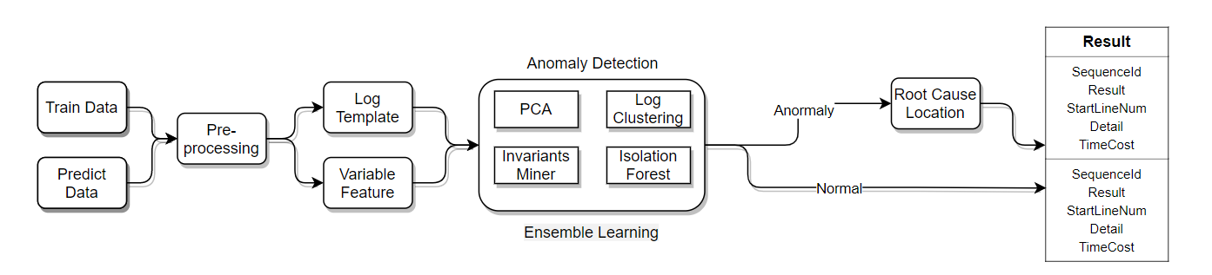
Our Solution
Our solution consists of four key steps.
Log
Parsing
Feature Extraction
Anomaly Detection
Root Cause Location
Template + variable
HTTP/<*>.<*>" status: <*> len: <*> time: <*>.
AMQP server on controller:<*> is unreachable: <*> <*> <*> Trying again in <*> seconds.
Template count
Variable distribution
Variable value
Semantic vector
Log Clustering
PCA
Invariants Miner
Isolation Forest
Domain Knowledge
Semantic Similarity
Stacked Autoencoders
Deep Belief Network

Slide 7
Our Solution – Log Parsing
Drain algorithm is used in log parsing to extract log templates and variables
ID | Date | Time | Pid | Level | Component | Req | Content | EventId | Event Template | ParameterList
1 | 2021-05-21 | 14:37:51.029 | 28838 | INFO | glance.common.wsgi | [-] | Starting 160 workers | 4f8bdedb | Starting <*> workers | [‘160’]
2 | 2021-05-21 | 14:37:51.034 | 28838 | INFO | glance.common.wsgi | [-] | Started child 28848 | ff2d50fe | Started child <*> | [‘28848’]
3 | 2021-05-21 | 14:37:51.037 | 28848 | INFO | eventlet.wsgi.server | [-] | (28848) wsgi starting up on http://0.0.0.0:9191/ | 7833b183 | (<*>) wsgi starting up on http:/<*>/ | [‘28848’,’/0.0.0.0:9191’]
4 | 2021-05-21 | 14:37:51.042 | 28849 | INFO | eventlet.wsgi.server | [-] | (28849) wsgi starting up on http://0.0.0.0:9191/ | 7833b183 | (<*>) wsgi starting up on http:/<*>/ | [‘28849’,’/0.0.0.0:9191’]
Total number of log templates: 900+
Number of training set log templates: 366
Number of detection log templates: 535
Number of log templates identical for both(Train & Detection): 30

Slide 8
Our Solution – Feature Extraction
6 key features are extracted from log patterns by data insight with expert knowledge.

Slide 9
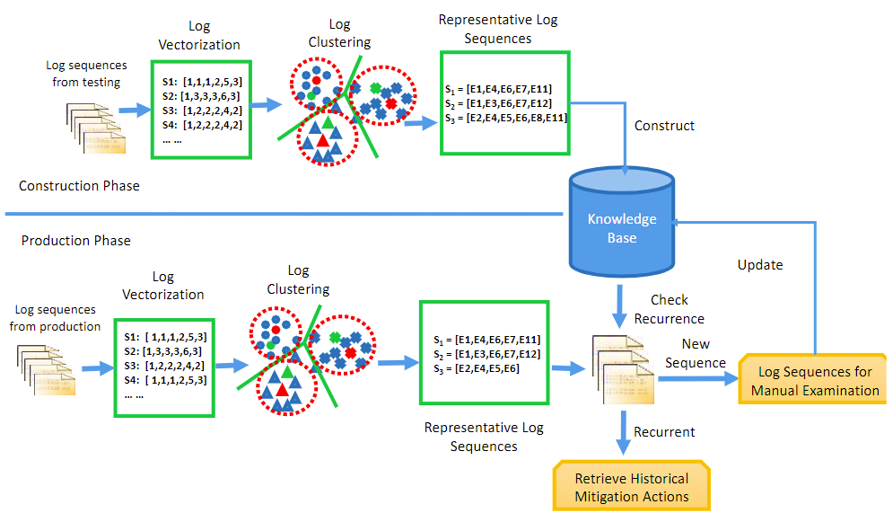
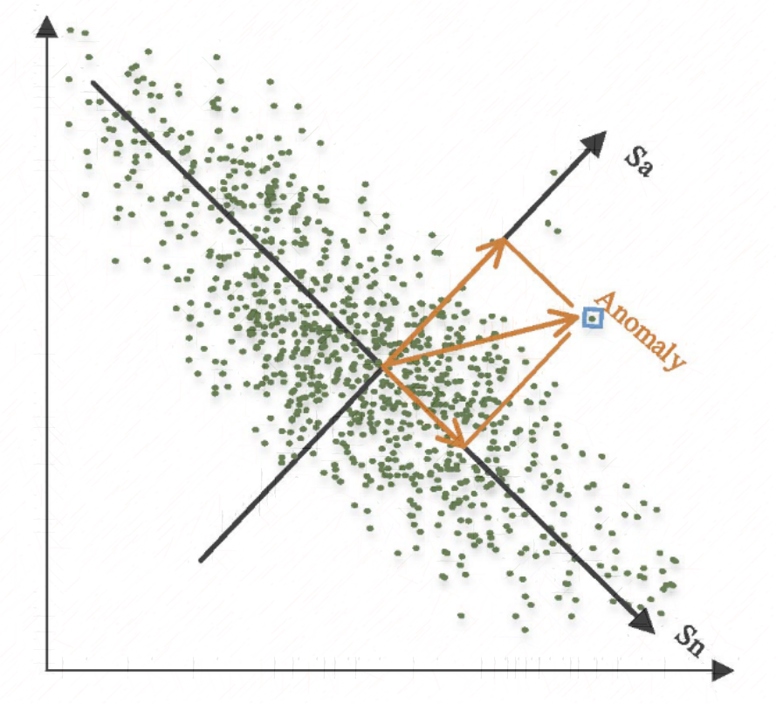
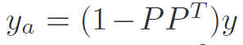
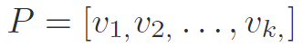
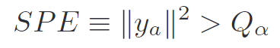
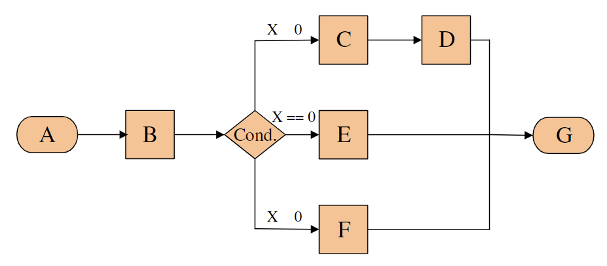
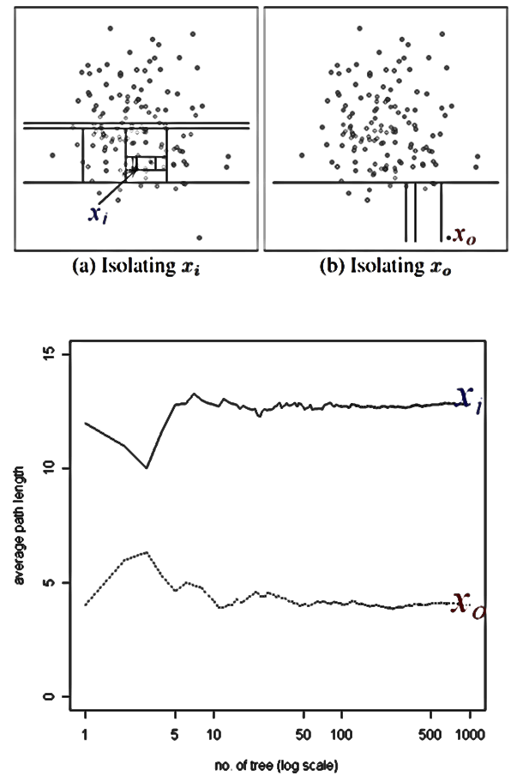
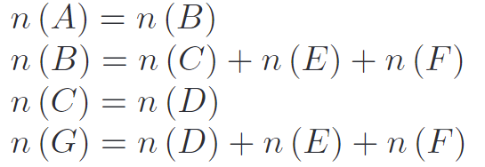
Our Solution – Log Anomaly Detection
4 kinds of unsupervised algorithms are selected to deal with various types of logs with complex anomaly patterns.
Notes:
of the algorithm.

Slide 10
Our Solution – Root Cause Location
Neural network and similarity calculation are used for root cause generalization to locate more root causes.
Root cause template | F1-Score
AMQP server on controller:<*> is unreachable: [Errno 104] Connection reset by peer. Trying again in <*> seconds. | 0.612
Similar template | Similarity
AMQP server on controller:<*> is unreachable: timed out. Trying again in <*> seconds. | 0.81
AMQP server on controller:<*> is unreachable: Too many heartbeats missed. Trying again in <*> seconds. | 0.79

Slide 11
Highlights – Log Anomaly Patterns Classification
4 patterns of log anomaly are classified to make the detection more accurate and interpretable.
Variable distribution anomaly
Template count anomaly
A
Status
code
B
Keywords anomaly
Variable value anomaly
Errno AMQP server on controller:<*> is unreachable: [Errno 104] Connection reset by peer. Trying again in <*> seconds.
Time
cost
Failed to compute_task_migrate_server: No valid host was found. There are not enough hosts available.

Slide 12
Highlights – Ensemble Learning
The Ensemble Learning of 4 unsupervised algorithms highly optimizes the performance in log anomaly detection.
Id | Algorithm | Precision | Recall | F1-Score
1 | Log Cluster | 0.529 | 0.725 | 0.612
2 | PCA | 0.455 | 0.686 | 0.547
3 | Invariants Miner | 0.683 | 0.843 | 0.754
4 | Isolation Forest | 0.538 | 0.686 | 0.603
5 | Ensemble Learning | 0.694 | 0.980 | 0.813
Precision: +52%, Recall: +42%, F1-Score: +48%.

Slide 13
Highlights – Root Cause Generalization
Root Cause Generalization highly improves the accuracy in RCL.
Algorithm | Log Anomaly Detection | Root Cause Location
Precision | 0.694 | 0.943
Recall | 0.980 | 0.980
F1-Score | 0.813 | 0.962
Precision: +35% , F1-Score: +18%

Slide 14



Highlights – Commercial Product
The total solution is provided as Docker Image to fit all kinds of deployment scenarios.
Host Machine
Docker Daemon
Build
Docker
Images
Docker
Containers
Dockerfile
Docker CLI
Capability scheduling、Self-healing、Horizontal
Expansion and Data Sharing
Web Interface、Virtualization、CI/CD

Slide 15
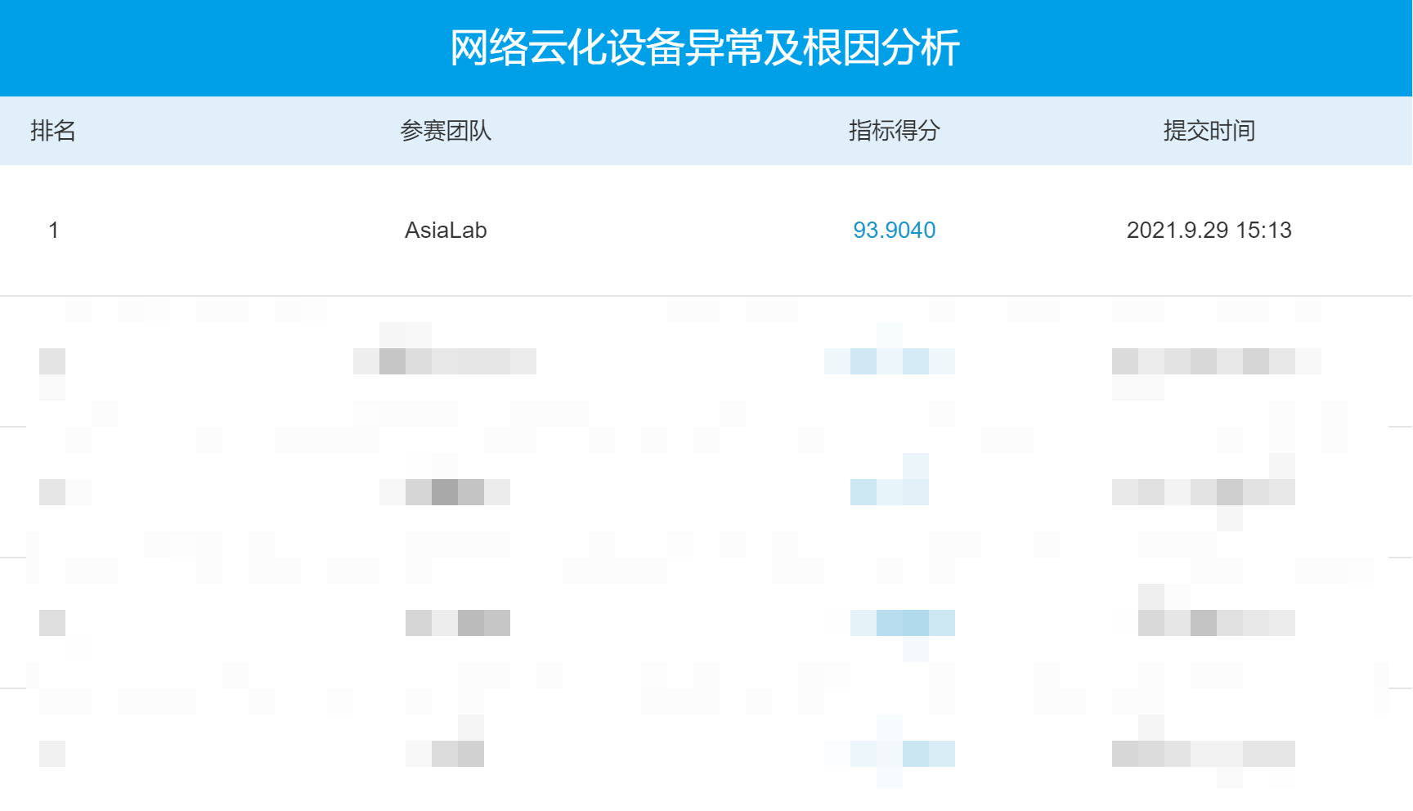
Achievements – Competition
Top1 score at China Mobile 5G AI/ML Special Competition.
Final Score: 93.9
Prediction accuracy: 94%
Training time: 10 min
Single prediction: 1 ms
Operating environment： 8 core 32G CPU
Highest score obtained

Slide 16
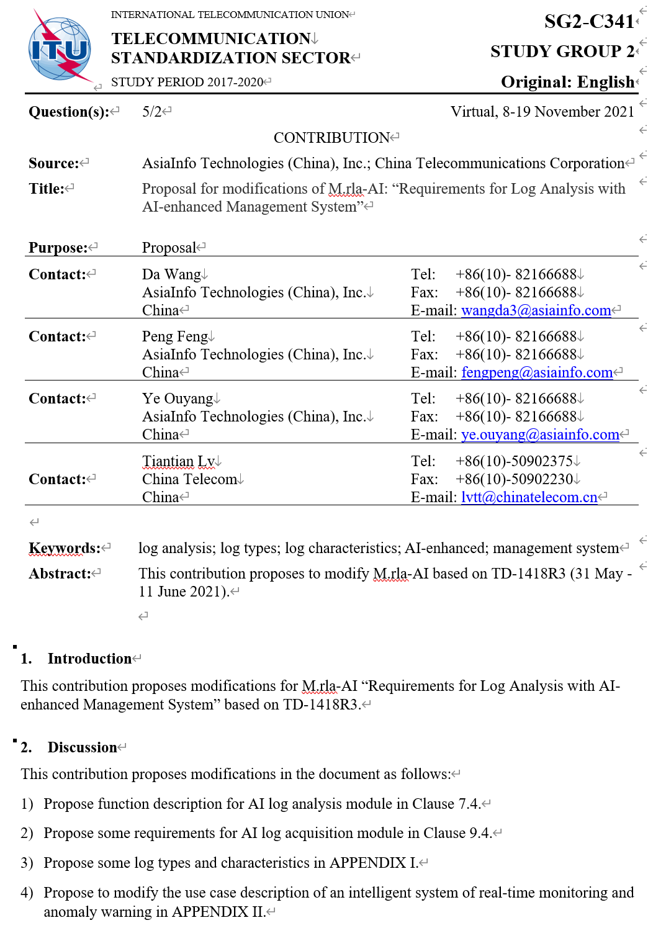
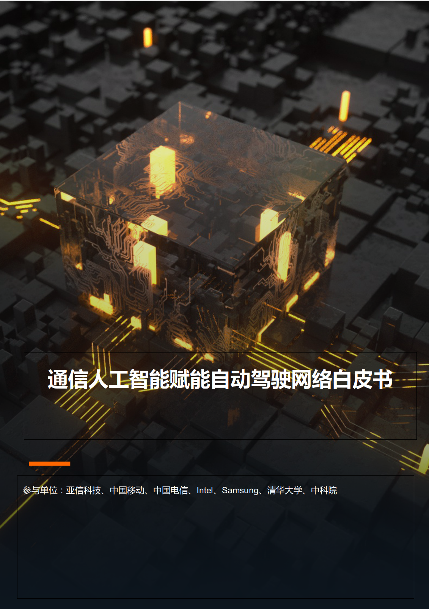
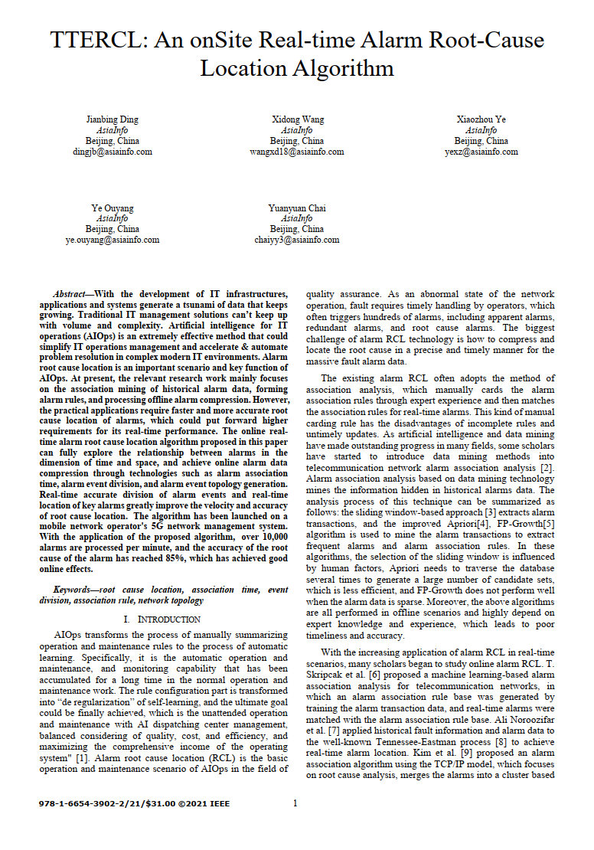
Achievements – Research
Approved ITU Proposal
Published White Paper
Accepted Paper
Proposal for M.rla-AI (Requirements for Log Analysis with AI-enhanced Management System) approved, 19/11/2021.
AI-enabled telecommunication autonomous networks white paper published on China mobile global partner conference 2021.
TTERCL: An onSite Real-time Alarm Root-Cause Location Algorithm will be published in 2021 IEEE Conference on
BigData .

Slide 17
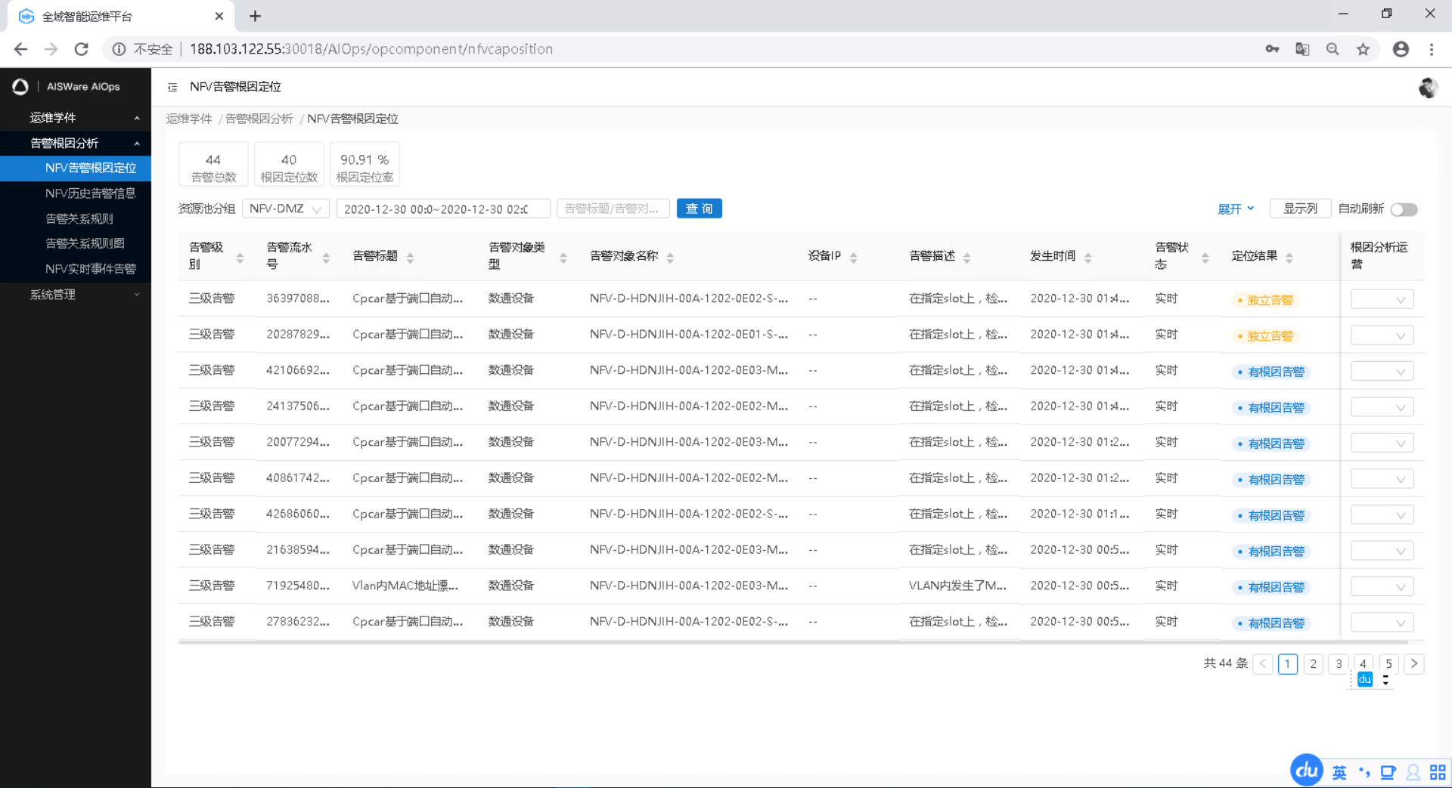
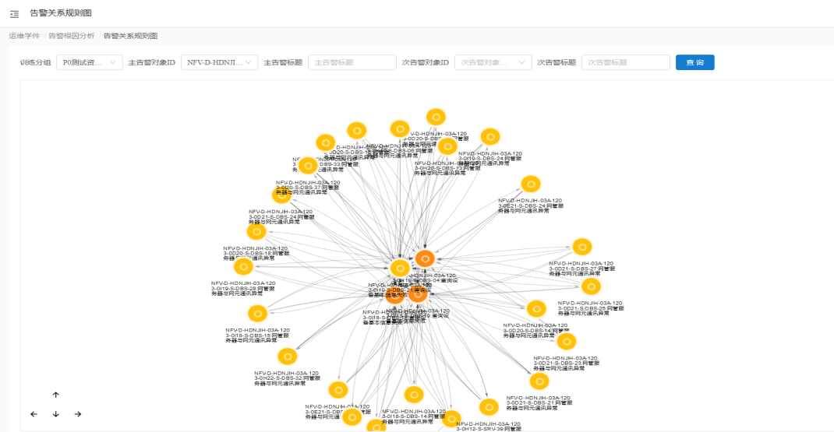
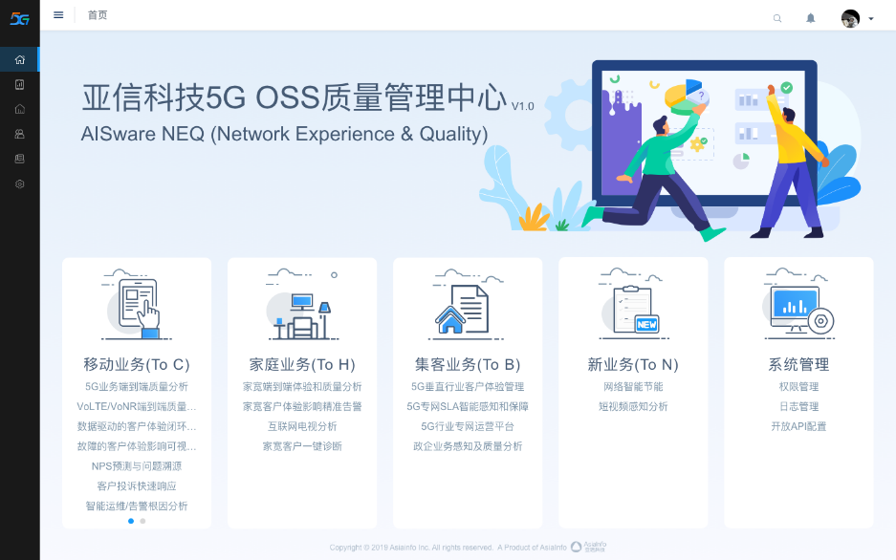
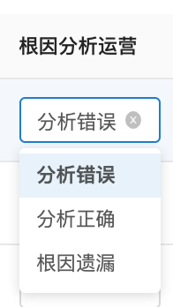
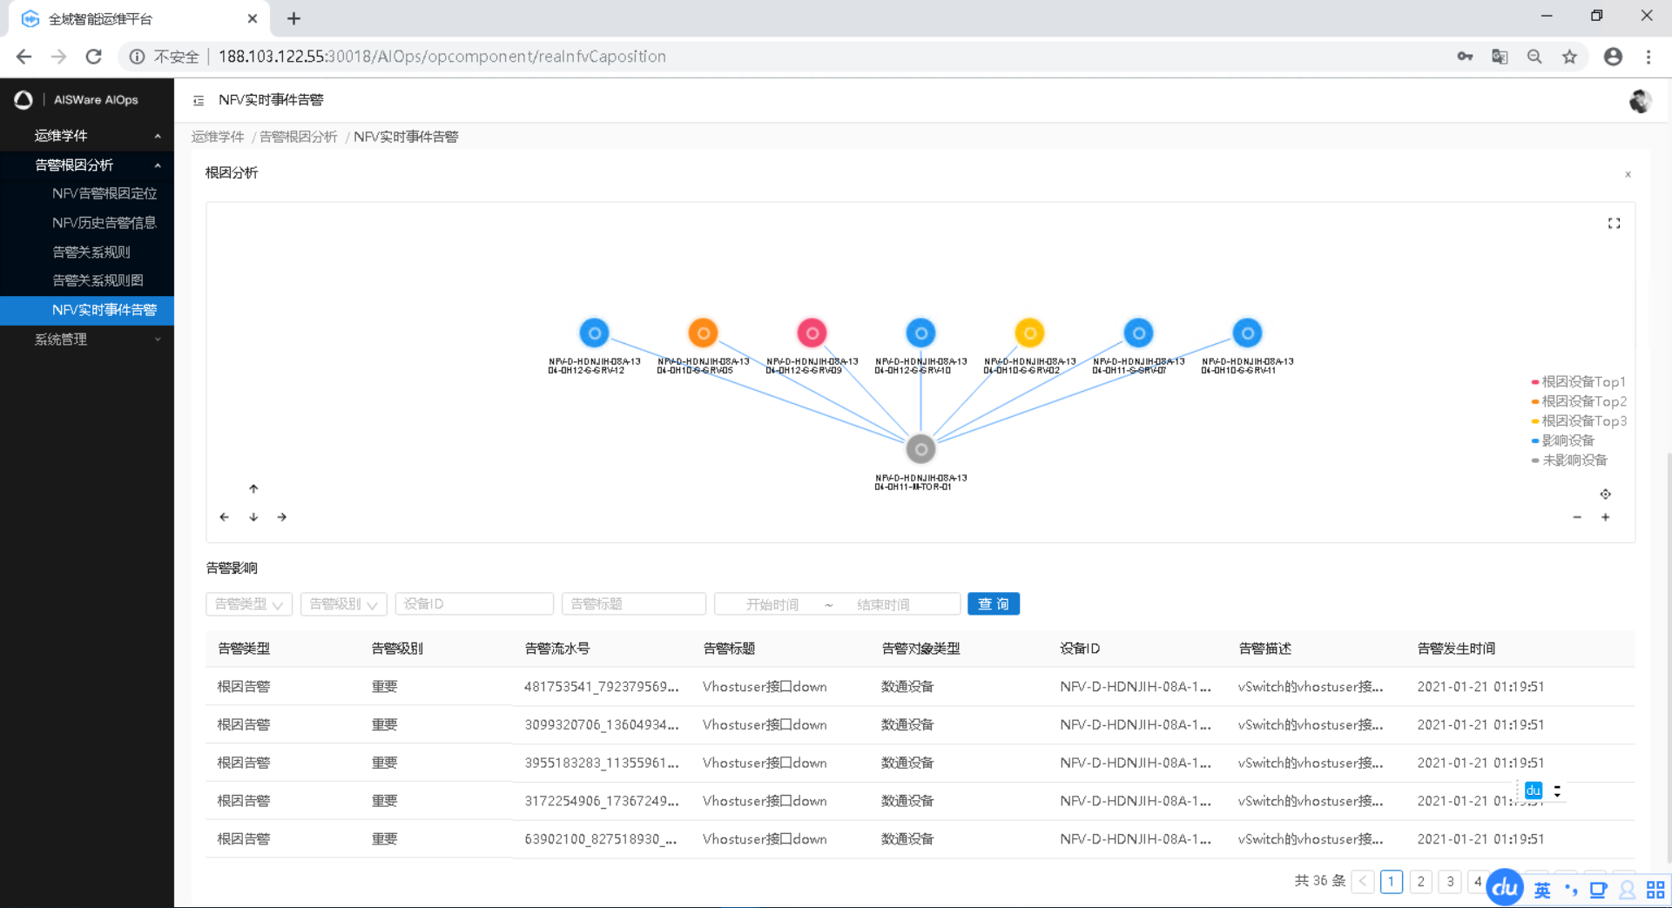
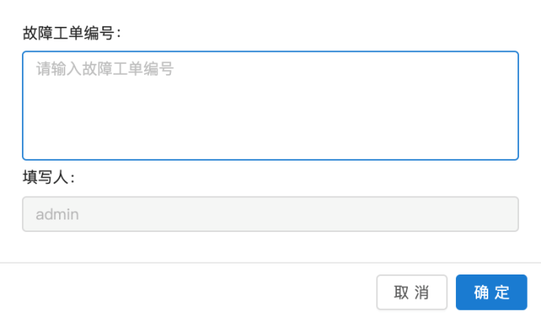
Achievements – Applications
The solution was integrated in network E&Q system deployed in 10+ provinces of China.
Network cloud fault display
Real-time fault root cause location
Fault propagation diagram display
Aid to judge the impact of the fault
Summarize fault rules
Improve root cause location accuracy
Fault event analysis

Slide 18
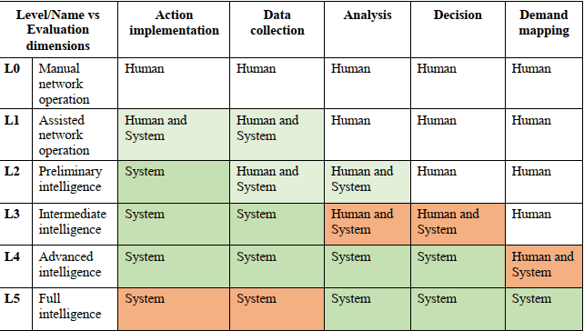
Outlook
Multi-modal data analysis including tracing, metrics, and logging will be utilized to improve network AIOps intelligence level.
Evaluation of network intelligence level on alarm RCA and fault recovery ：ITU-T Y.3173 P21，Table II-3
Request-scoped metrics
Tracing
Metrics
Aggragatable events
e.g. rollups
Logging
Request-scoped
Aggragatable events
Request-scoped events

Slide 19

Thank you
Notes:
That`s all

